Slide 1

CSc 4780/6780
Fundamentals of Data Science
Python Basics

Slide 2

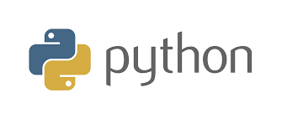
Python
Developed by Guido van Rossum, early 90s
Named after Monty Python
Interpreted language
  work with an evaluator for language expressions (like Java, but more flexible)
Dynamically typed: variables do not have a predefined type
Rich, built-in collection types:
  Lists
  Tuples
  Dictionaries (maps)
  Sets
Concise

Slide 3
Python Features
Indentation instead of braces
Several sequence types
  Strings ’...’: made of characters, immutable
  Lists [...]: made of anything, mutable
  Tuples (...) : made of anything, immutable
Powerful subscripting (slicing)
Functions are independent entities (not all functions are methods)
Exceptions as in Java
Simple object system
Iterators (like Java) and generators

Slide 4
Python Features
Good example of scripting language
“Pythonic” style is very concise
Powerful but unobtrusive object system
  Every value is an object
Powerful collection and iteration abstractions
  Dynamic typing makes generics easy
Java: statically typed
  Variables are declared to refer to objects of a given type
  Methods use type signatures to enforce contracts
Python
  Variables come into existence when first assigned
  A variable can refer to an object of any type
  All types are (almost) treated the same way
  Main drawback: type errors are only caught at runtime

Slide 5
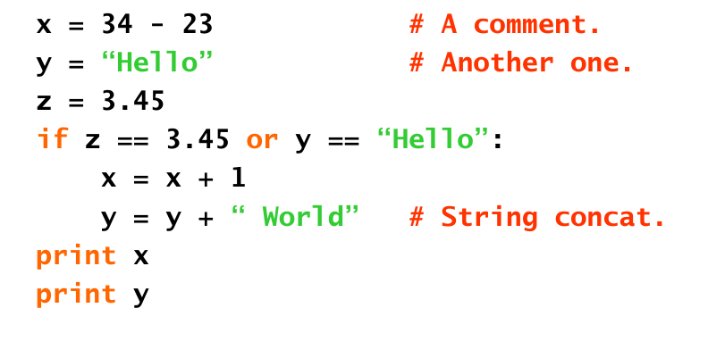
Python Basics

Slide 6
Python Basics
Indentation matters to the meaning of the code:
  Block structure indicated by indentation
The first assignment to a variable creates it.
  Variable types do not need to be declared.
  Python figures out the variable types on its own.
Assignment uses = and comparison uses ==.
For numbers + - * / % are as expected.
  Special use of + for string concatenation.
  Special use of % for string formatting (as with printf in C)
Logical operators are words (and, or, not) not symbols
Simple printing can be done with print.

Slide 7
Basic Data Types
Integers (default for numbers)
  z = 5 / 2 # Answer is 2.5 in Python 3+
  Z_int = 5 // 2 = # Answer is 2 in Python 3+
Floats
  x = 3.456
Strings
  Can use “...“ or ‘...‘ to specify.
  “abc” or ‘abc’ (Same thing.)
  Unmatched can occur within the string. “Matt’s”
  Use triple double-quotes for multi-line strings or strings than contain both ‘ and “ inside of them: “““a‘b“c”””

Slide 8
Whitespace
Whitespace is meaningful in Python: especially indentation and placement of newlines.
Use a newline to end a line of code.
Use \ when must go to next line prematurely.
No braces { } to mark blocks of code in Python. Use consistent indentation instead.
  The first line with less indentation is outside of the block.
  The first line with more indentation starts a nested block
Often a colon appears at the start of a new block. (e.g., for function and class definitions.)

Slide 9
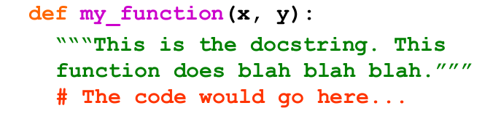
Comments
Start comments with # – the rest of line is ignored.
  Can include a “documentation string” as the first line of any new function or class that you define.
  The development environment, debugger, and other tools use it: it is good style to include one.

Slide 10
Assignment
Binding a variable in Python means setting a name to hold a reference to some object.
  Assignment creates references, not copies (like Java)
A variable is created the first time it appears on the left side of an assignment expression:
  x = 3
An object is deleted (by the garbage collector) once it becomes unreachable.
Names in Python do not have an intrinsic type.
Objects have types.
  Python determines the type of the reference automatically based on what data is assigned to it.

Slide 11
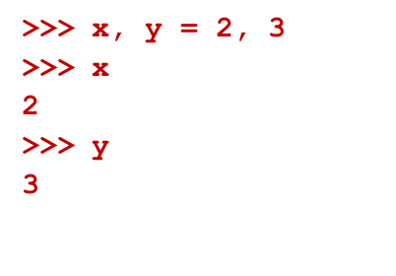
Multiple Assignment
You can also assign to multiple names at the same time.

Slide 12
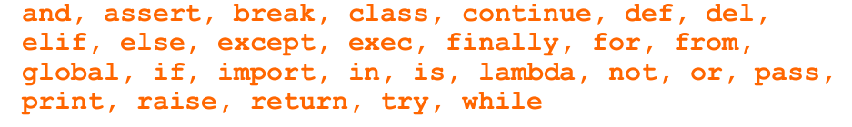
Naming rules
Names are case sensitive and cannot start with a number. They can contain letters, numbers, and underscores.
  bob, Bob, _bob, _2_bob_, bob_2, BoB
There are some reserved words:

